Slide 1
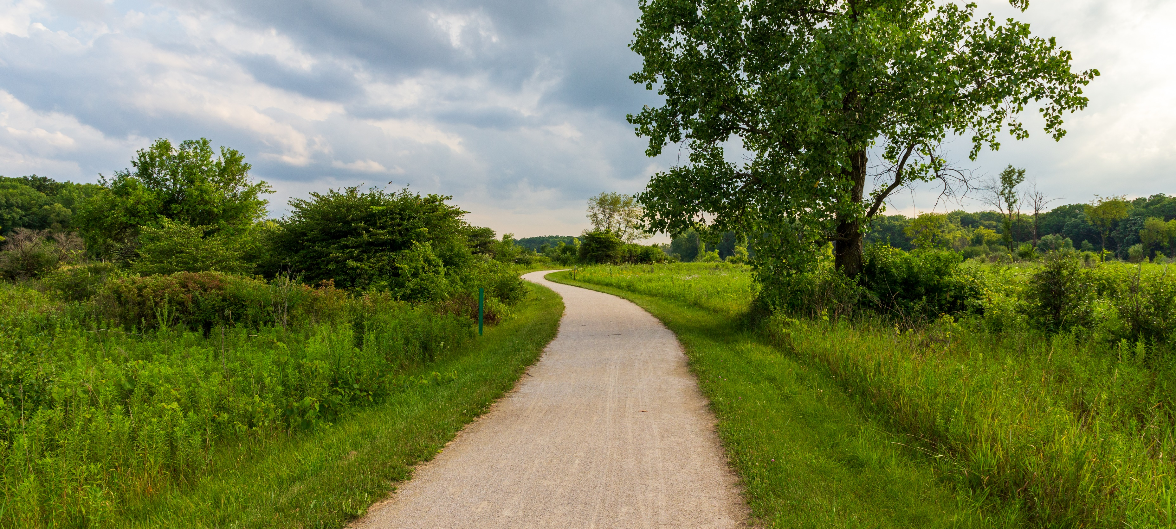
Conservation Economics at TPL
Moraine Hills State Park, McHenry, IL
Valuing our Parks, Trails, and Open Spaces

Slide 2
Access to the outdoors is a fundamental human need and essential to our health and well-being.
PEOPLE NEED PARKS.

Slide 3
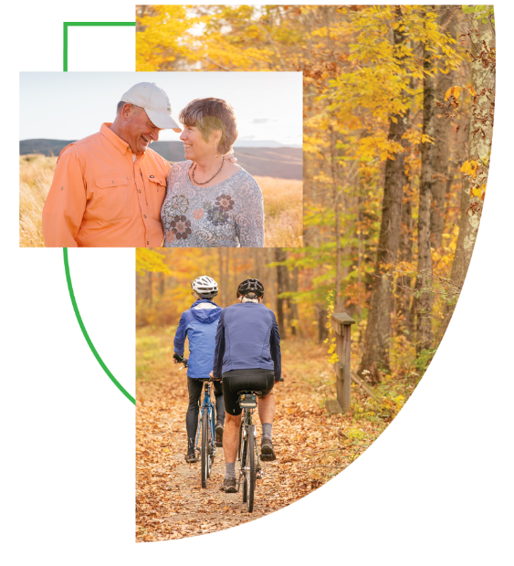

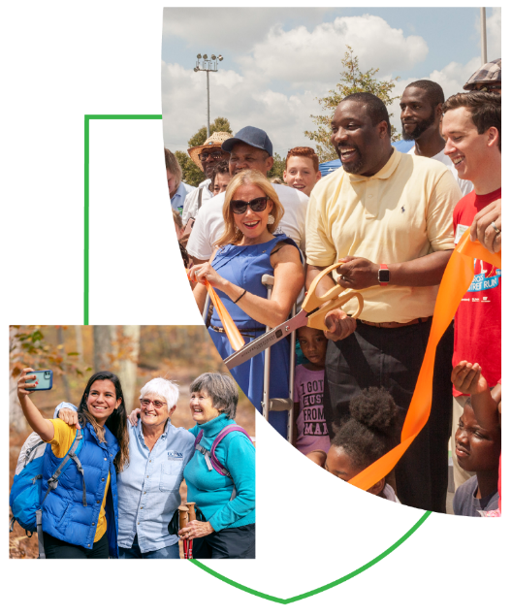
Communities that place a high value on
OUTDOOR ACCESS FOR ALL ARE
HEALTHIER
MORE RESILIENT
MORE EQUITABLE

Slide 4

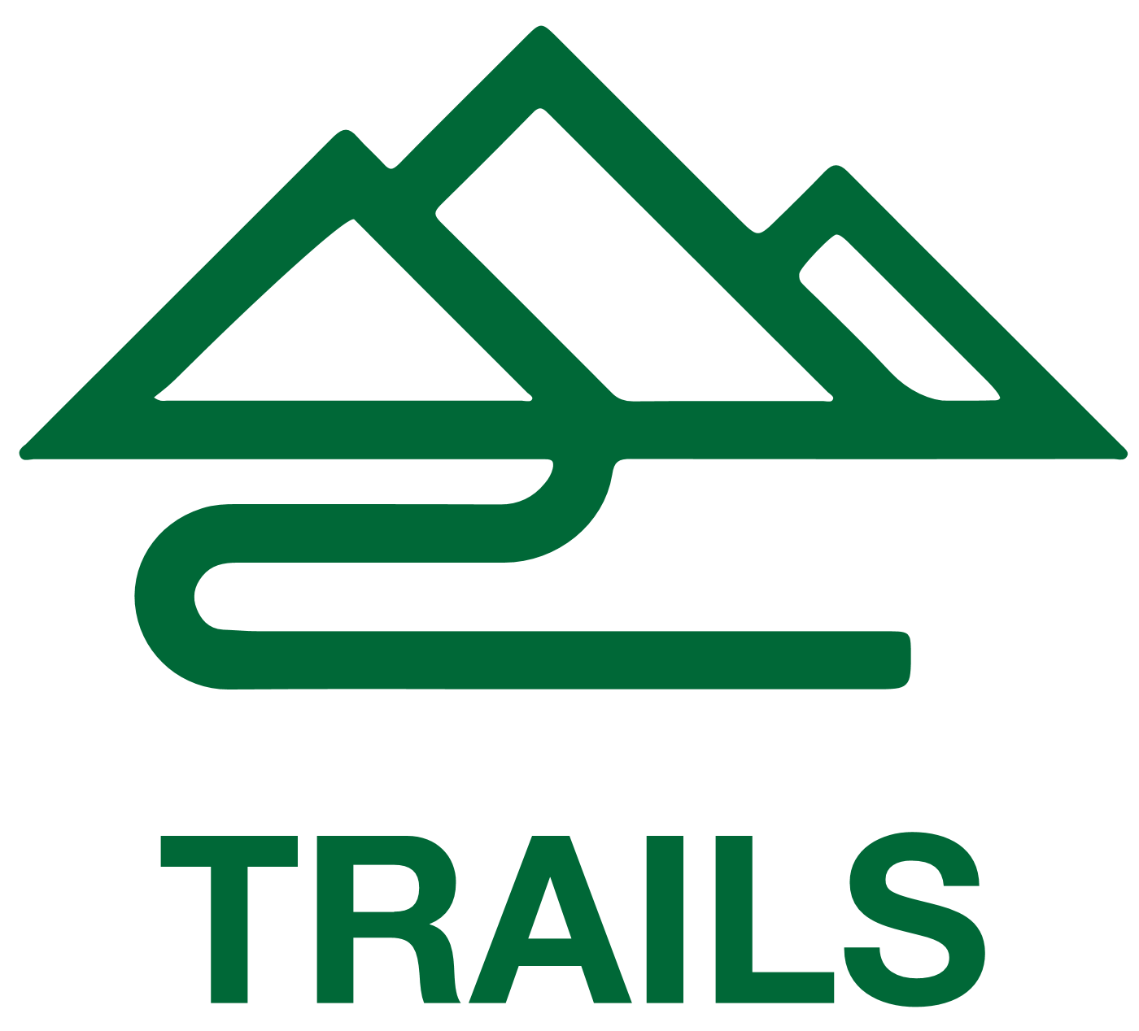


OUR MISSION
WHY we do it
WHAT we do
HOW we do it
OUR INTITIATIVES
OUR COMMITMENTS
OUR TOOLKIT
PUBLIC LAND FOR
PUBLIC GOOD
FUNDING AND LEVERAGE
DATA AND
INSIGHT
ADVOCACY
PARK CREATION AND TRANSFORMATION

Slide 5
We are
CONNECTING EVERYONE TO THE OUTDOORS

Slide 6
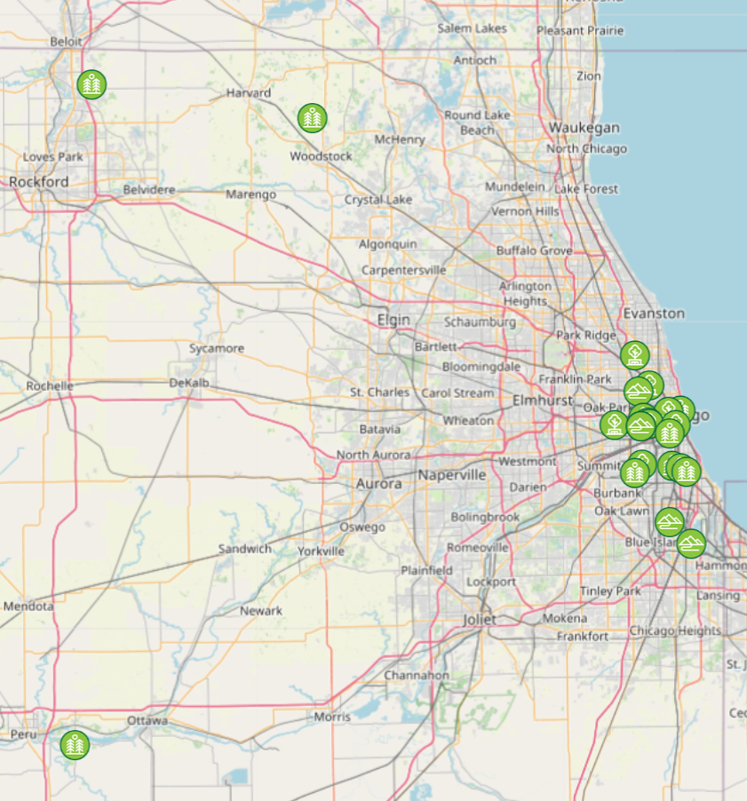
TPL in Illinois
https://www.tpl.org/state/illinois
4,321 acres of land protected
166,190 people connected to the outdoors
41 active and completed projects, including:
  The Englewood Nature Trail
  Hackmatack National Wildlife Refuge
  The Great Migration Greenway, anchored at Emmet Till’s childhood home and the Mamie Till-Mobley Forgiveness Garden

Slide 7
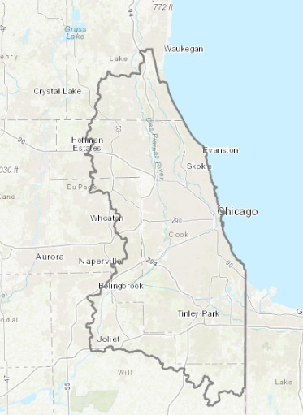
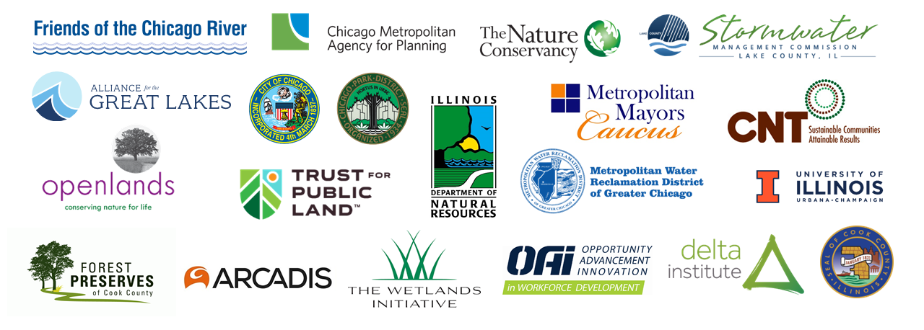
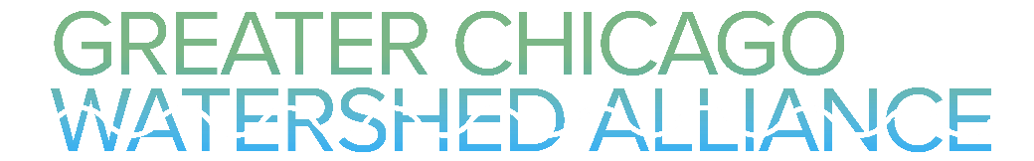
Climate Smart Cities: Chicago
https://web.tplgis.org/chicago_nst/
Part of a larger TPL program spanning 15 cities across the US
Goal: Advancing nature-based solutions (NBS) through a unique approach to people and data-driven planning
Created online tool to help prioritize NBS investments
Notes:
The tool analyzes a massive amount of data – 84 data sets in all – to identify parcels that would see the maximum impact for a given investment. That included demographic information, public health data, equity considerations, biodiversity and native plantings, trail and greenway connections and more.

Slide 8
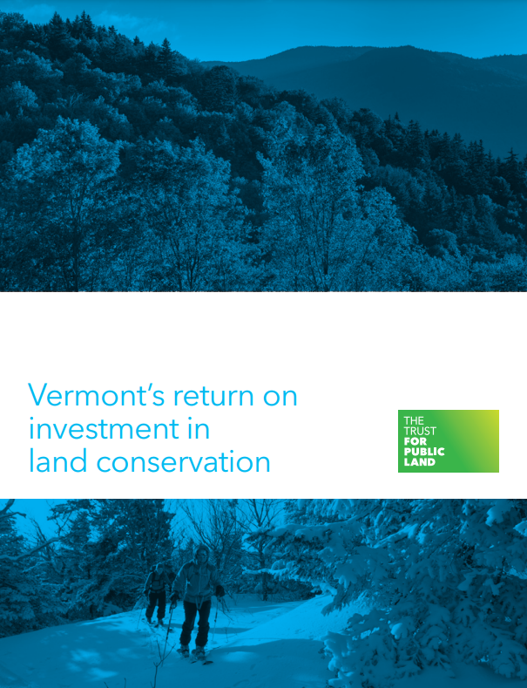
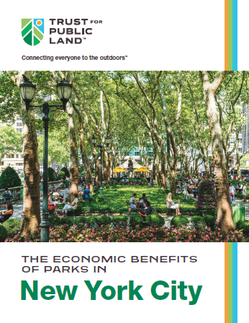
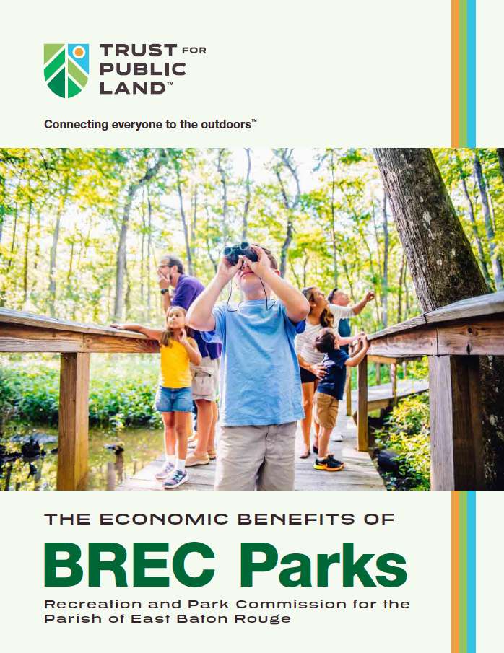
Conservation Economics
at Trust for Public Land
How do people value parks, conserved lands, trails, and outdoor recreation?
How do these spaces contribute to economic development?
What benefits (or ecosystem services) does nature provide in these spaces?
Notes:
Conservation Economics is the use of economics to understand the costs and benefits of sustaining natural ecosystems. Its purpose is to accomplish more widespread and lasting conservation by revealing its benefits and fitting it within genuine economic development.

Slide 9
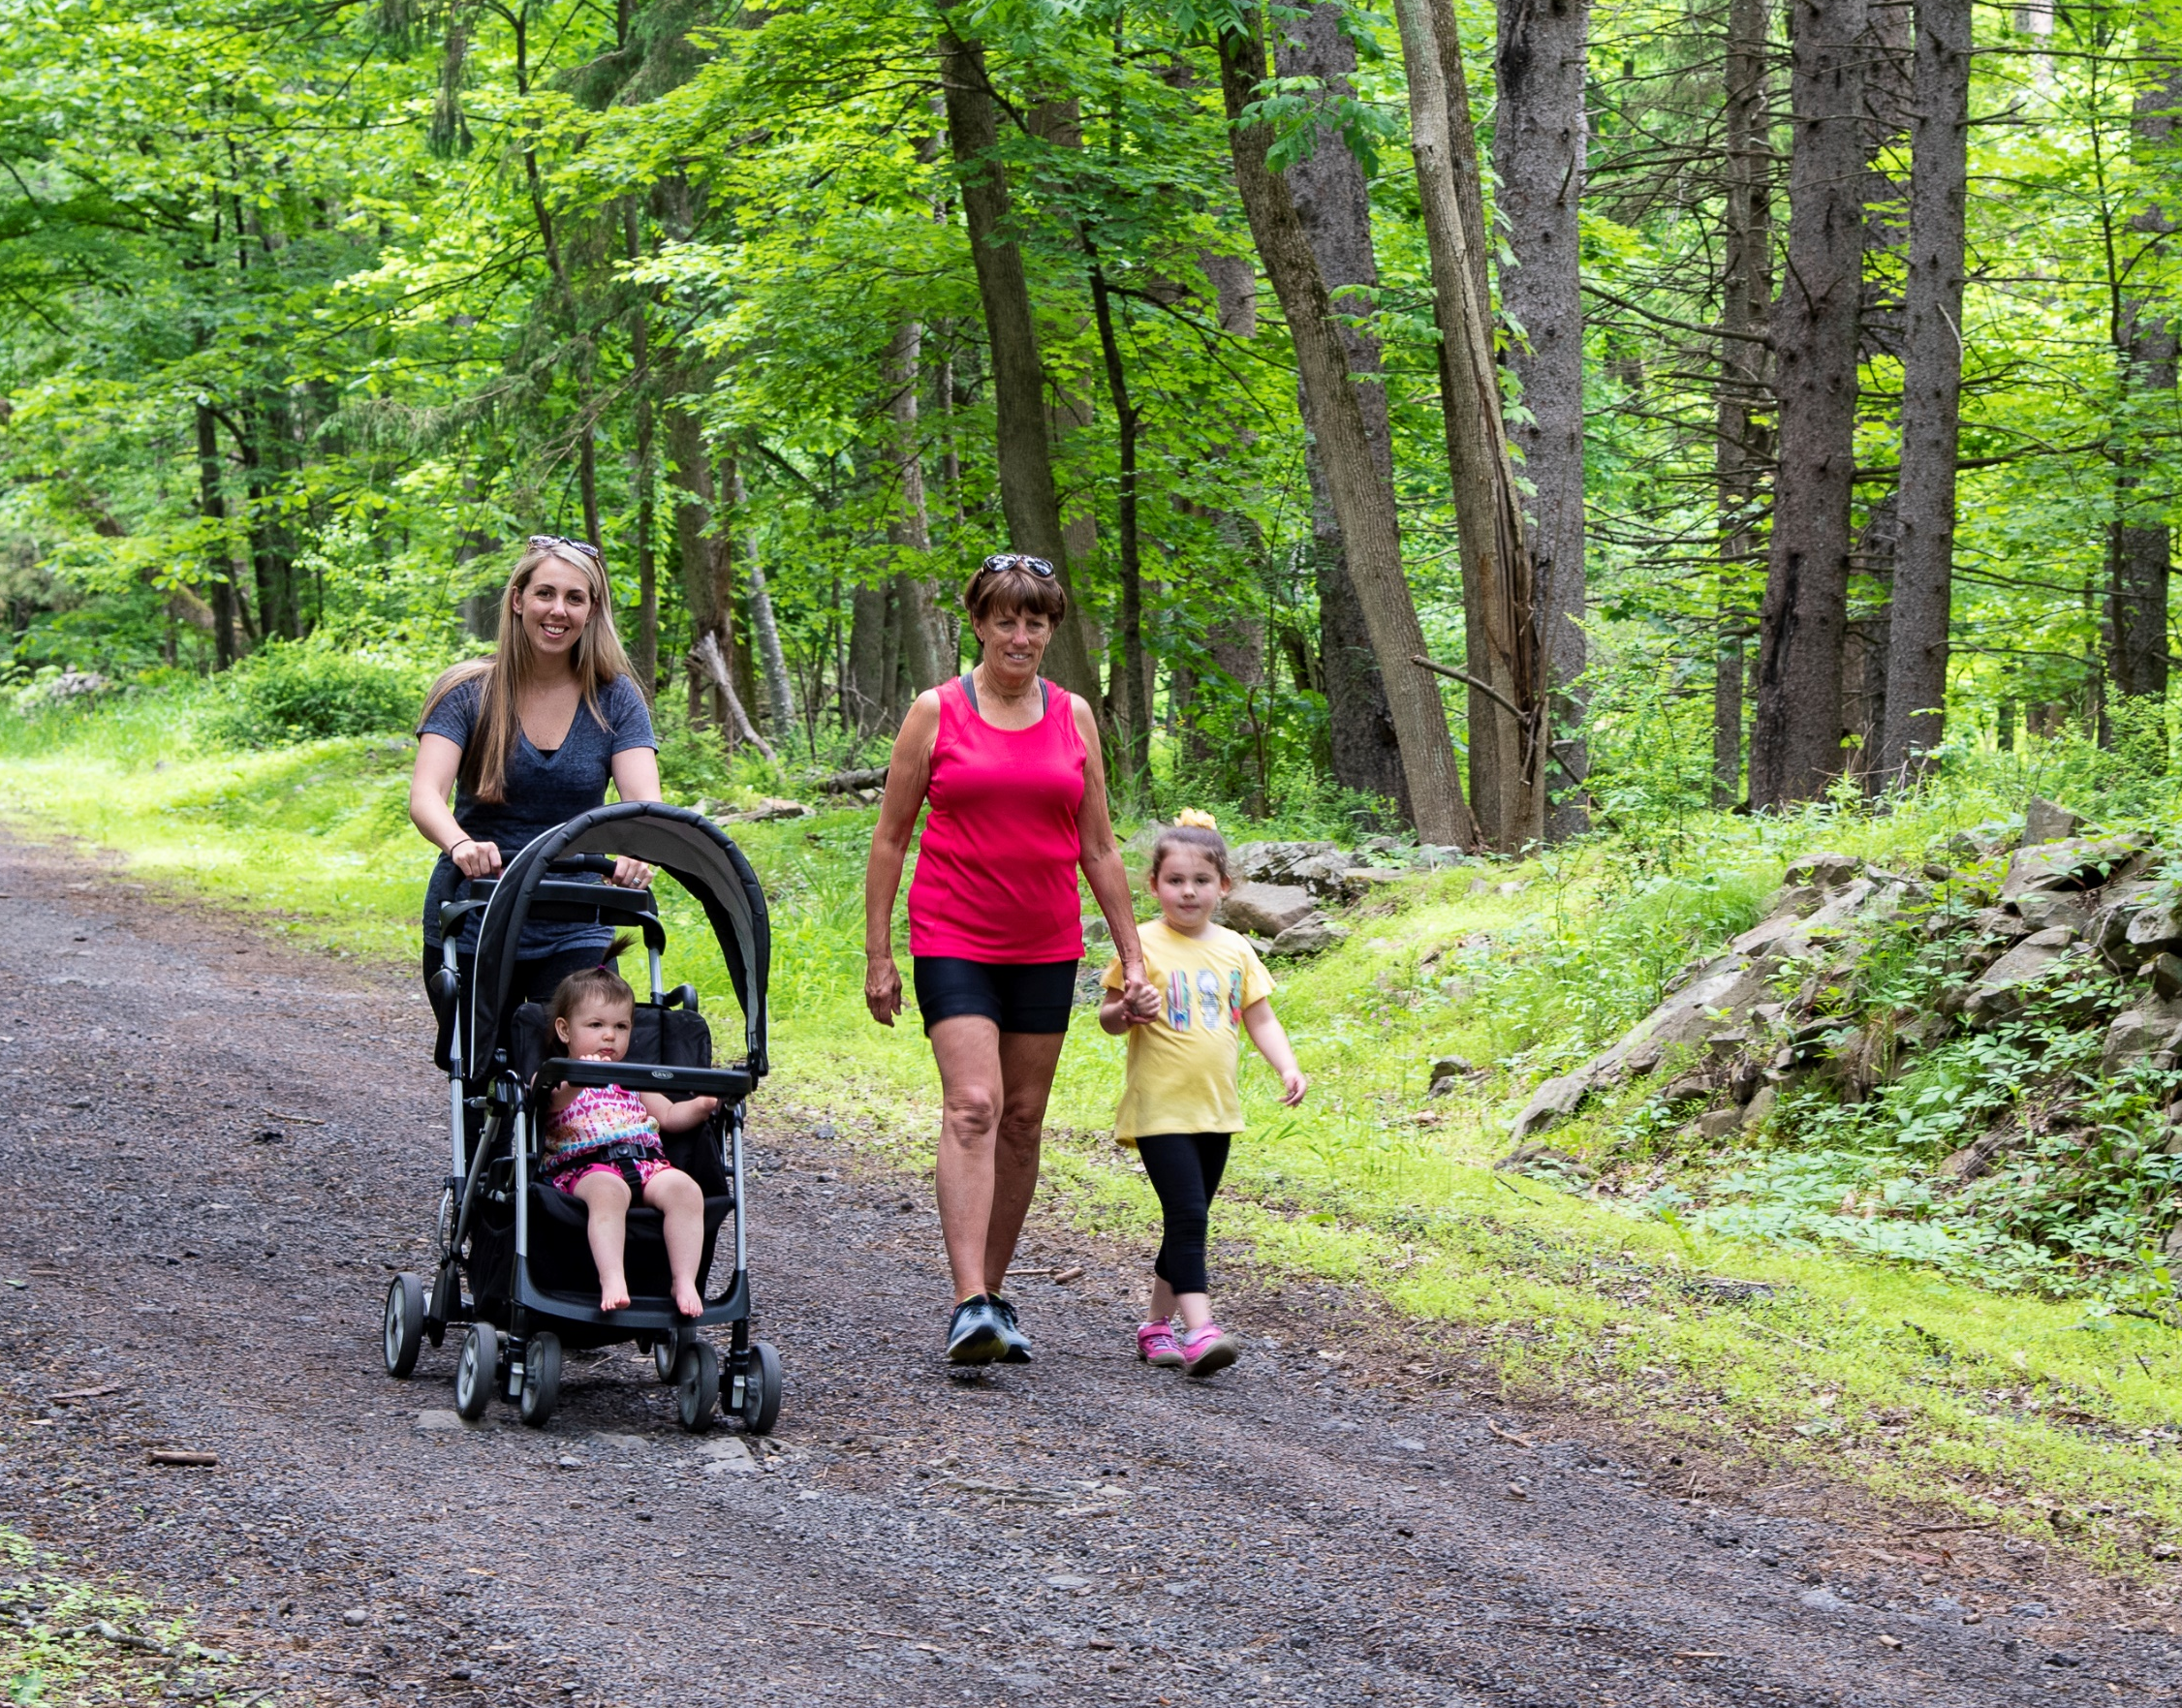
Recreational Use by Residents
Park and trail visitors obtain value from these visits, even if they don’t purchase tickets or pay entrance fees
Conduct statistically valid survey of residents to estimate their park and trail use, then estimate recreational value of visits using survey results, benefits transfer, and the US Army Corps of Engineer’s Unit-Day Value method

Slide 10
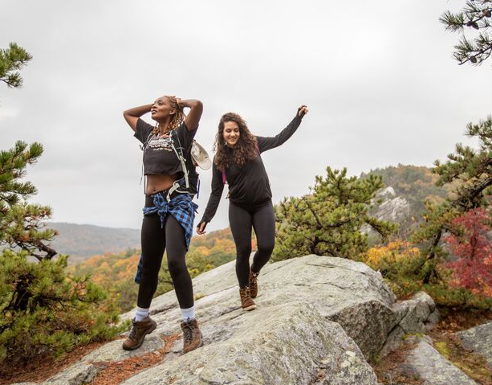
Improved Public Health
When people have access to nature, they exercise more
People who exercise more see reduced illness in people of all ages
CDC sets recommendations for physical activity to lower the risk for long-term health issues
Using park use data, estimate level of physical activity; if CDC guidelines are met, estimate annual healthcare cost savings per year using benefits transfer

Slide 11
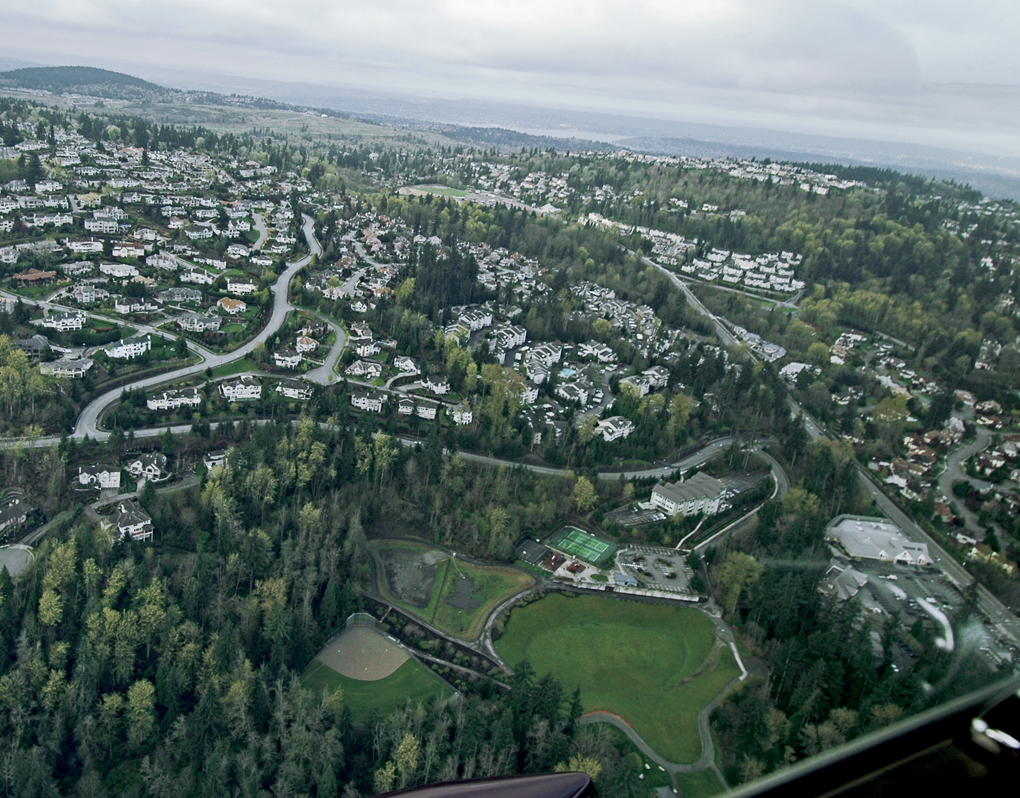
Enhanced Property Value
Homes near parks and trails are frequently higher value than comparable homes located elsewhere
An increase in property values generally results in increased property tax revenues
The magnitude of the benefit (both its value and distance the home is from the park) depend on the quality and size of the park
Using hedonic analysis, estimate the increase in property value and associated property tax due to proximity to parks, trails, and green spaces

Slide 12
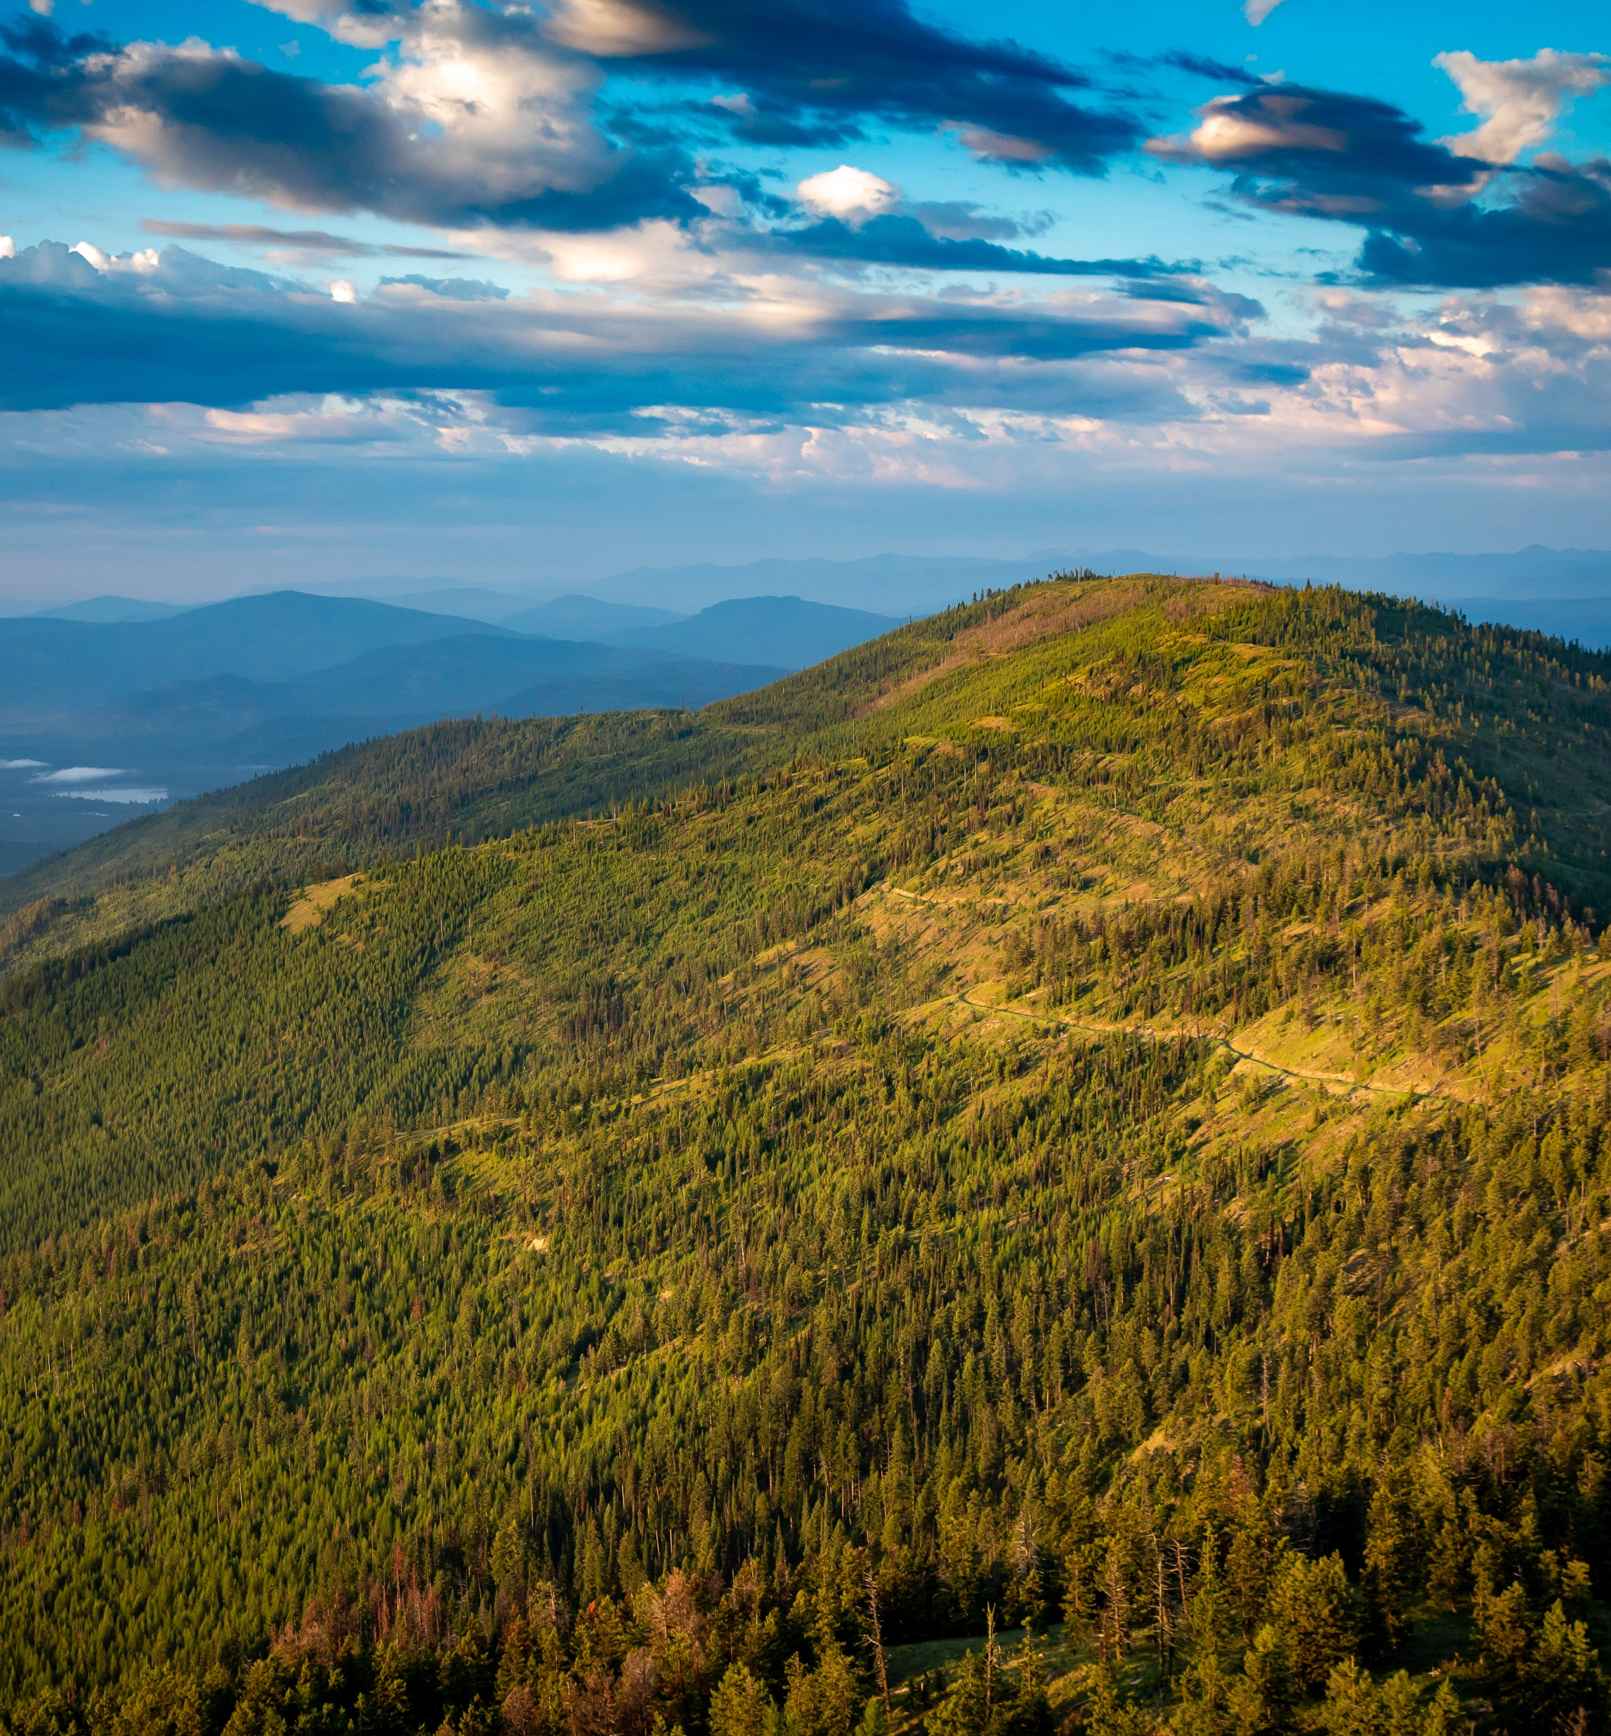
Air Pollution Reduction
Trees, plants, and other vegetation improve air quality by removing air pollutants, including:
  Carbon monoxide
  Nitrogen dioxide
  Ozone
  Particulate matter
  Sulfur Dioxide
Estimate the air pollution reduction benefits of parks and natural areas using the USDA Forest Service program i-Tree, and the US EPA BenMAP program to assign public health value associated with reduction

Slide 13
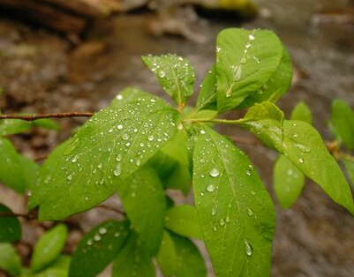
Stormwater Reduction
Parks can reduce stormwater runoff by capturing precipitation and/or slowing its runoff
Parks also reduce pollutants in stormwater runoff, overall reducing the costs of stormwater management
Estimate the reduced cost of stormwater management due to parks and natural areas using i-Tree program (gallons of water reduced per year * per gallon cost of stormwater management)

Slide 14
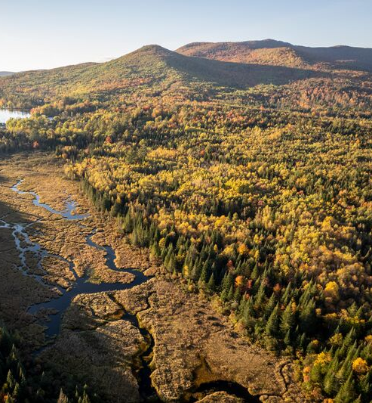
Carbon Storage and Sequestration
Trees and plants sequester (or absorb) carbon from the atmosphere and store it in its biomass (leaves, branches, roots)
TPL created the GIS-based Conservation Carbon Map to help estimate the value and rate of carbon sequestration and total carbon storage of forests
https://web.tplgis.org/carbonmap/

Slide 15
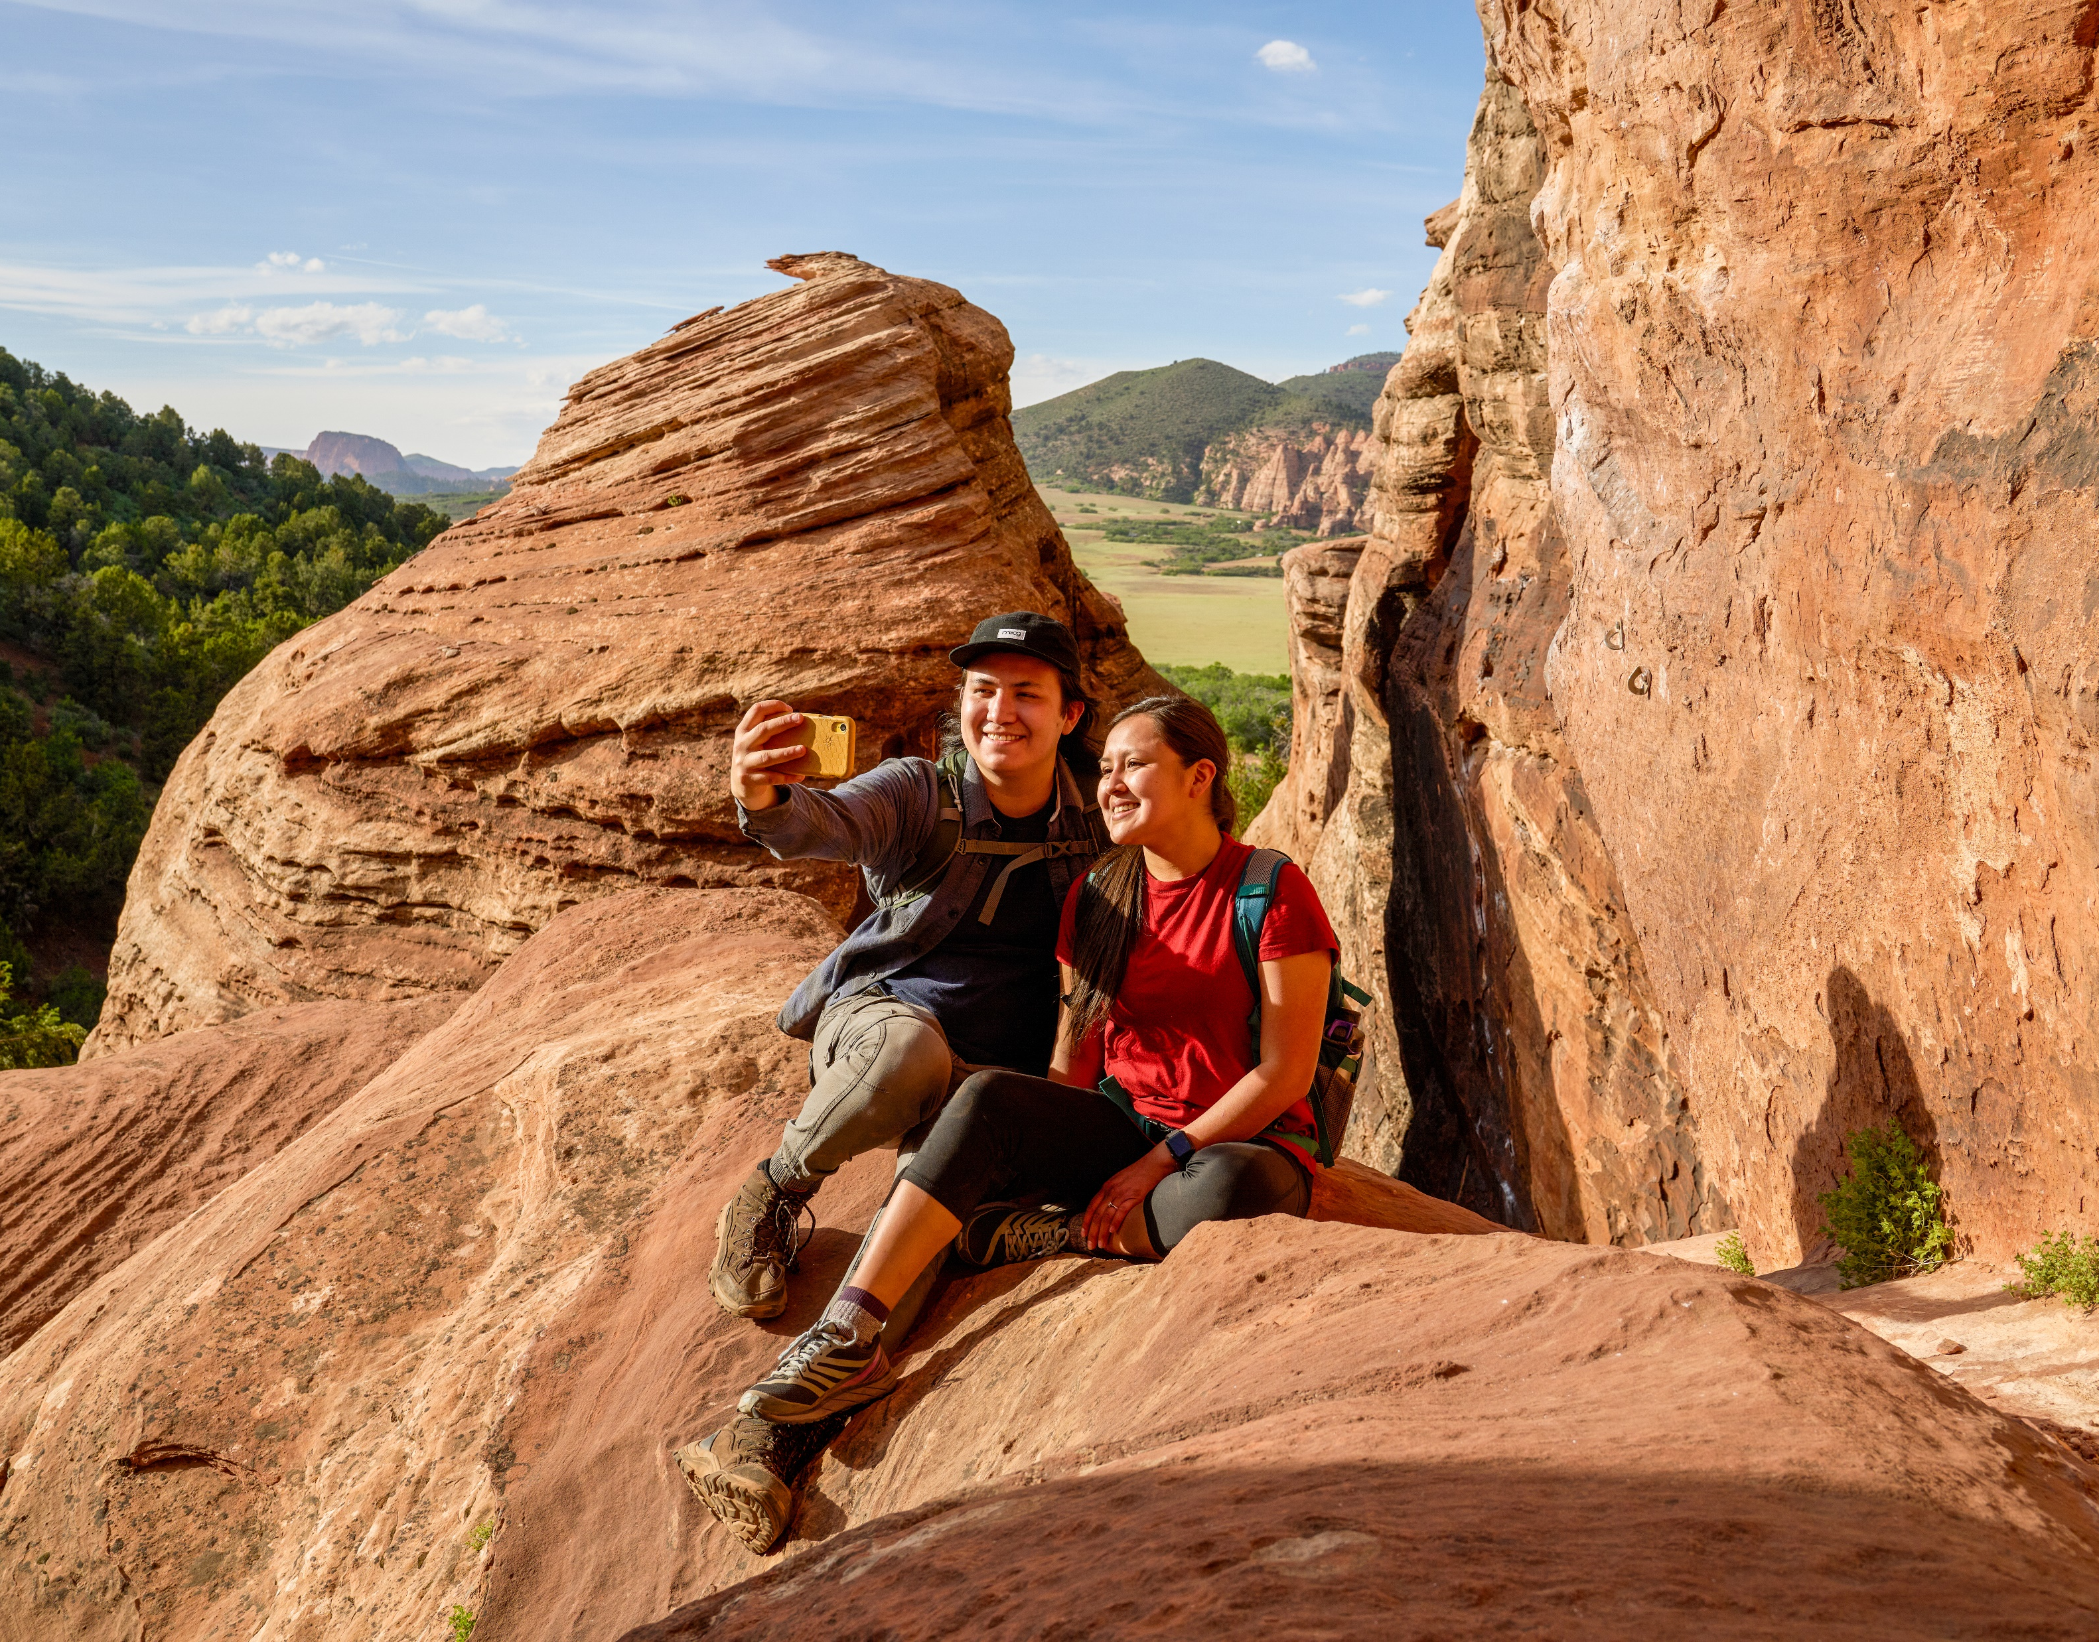
Tourism
Parks, trails, and recreational facilities attract non-residents to the area, spending dollars that otherwise may not be in the area
Sports Tourism in particular generates significant economic impacts; across the US in 2021, Tourism Economics and Sports ETA estimated $39.7 billion in direct spending due to tournaments
Estimate tourism due to outdoor recreation and/or sports tourism based on visitation data and estimated per-person expenditures (lodging, travel, entertainment, food, etc)
Notes:
Ideally wan to identify people who traveled over 50miles, to identify ‘true’ economic impact versus economic benefits. Can leverage registration/admissions data; anonymized cell phone data; third-party tourism data providers (e.g. Longwoods).

Slide 16
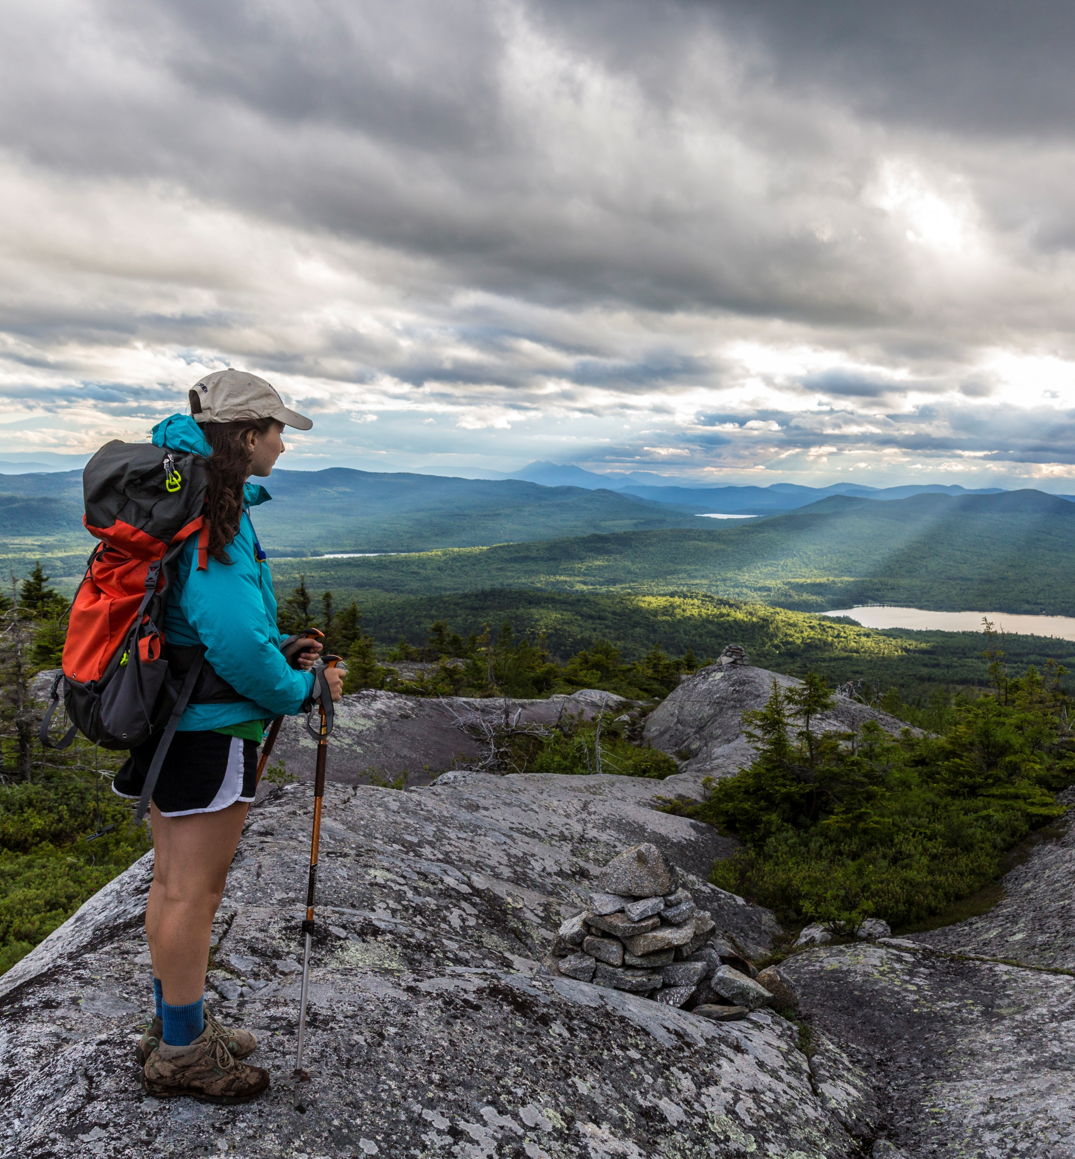
Outdoor Recreation Spending
People spend money on outdoor sports, recreation, and exercise equipment in order to participate in outdoor recreation activities
Esri Business Analyst models household budgets, market potential, and spending potential based on local demographics and spending patterns
Estimate the average expenditures of residents on equipment needed for outdoor recreation (also generates sales tax)

Slide 17
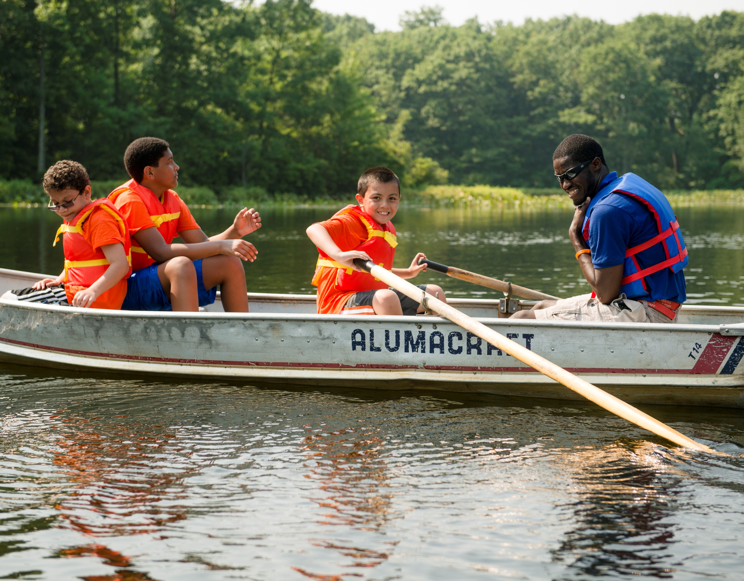
Benefits to Local Businesses
Outdoor recreation access encourages businesses to locate in nearby areas (either new or by expanding)
Nearby trails can also increase job opportunities, such as retail, accommodations, tour guides, equipment manufacturing, wholesale, and more
Collect quantitative and qualitative data on economic development benefits to the local business community, through interviews, surveys, and other outreach to business owners and economic development leaders

Slide 18
Since 1972, TPL has protected 4 million acres of public land; created 5,364 parks, trails, schoolyards, and iconic outdoor places; raised $93 billion in public funding for parks and public lands; and connected nearly 9.4 million people to the outdoors.
To learn more, visit tpl.org.
Thank You
Jennifer Clinton
Senior Parks and Conservation Economist @ TPL
Jennifer.Clinton@tpl.org

Slide 19

Since 1972, TPL has created thousands of parks and protected millions of acres of public land.​
4M
ACRES PROTECTED
5,364
OUTDOOR SPACES CREATED
9.4M
PEOPLE CONNECTED
TO THE OUTDOORS
$94B
SECURED IN PUBLIC FUNDING

Slide 20


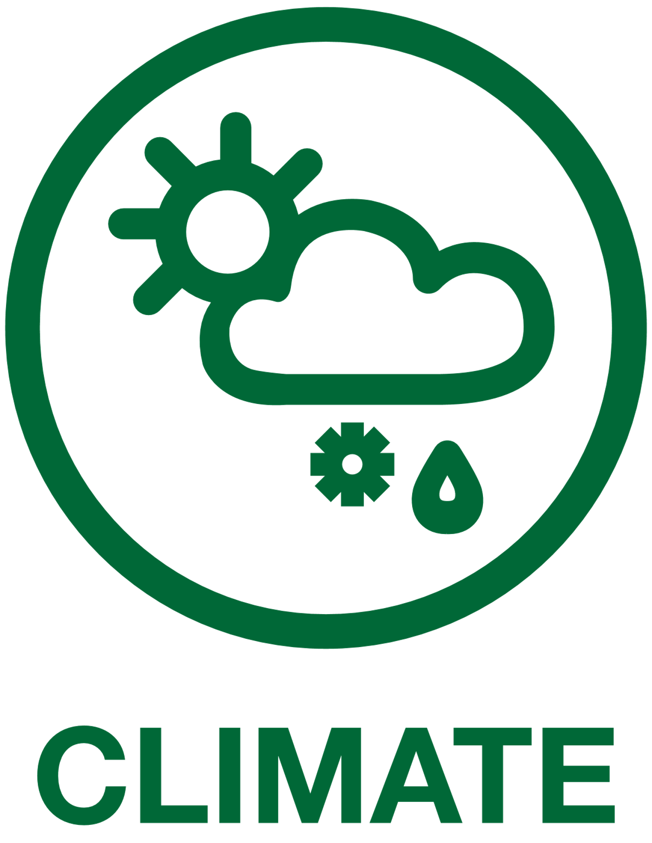

OUR COMMITMENTS
Everyone needs access to the benefits of nature. Working hand in hand with communities, we are closing the park equity gap by creating parks and protecting land where it's needed most.
We create opportunities for everyone to experience the physical and mental health benefits nature provides, from close-to-home parks to awe inspiring outdoor experiences.
The parks we create and the lands we protect safeguard people from extreme heat, poor air and water quality, flooding, and sea level rise, making communities more resilient and prepared for change.
We work alongside community members and leaders to create, protect and advance the outdoor places and spaces that are essential to everyone's well-being.

Slide 21
OUR INITIATIVES
We work with landowners, partner groups and public agencies to acquire, create access to, and secure public ownership and stewardship of the lands and waters that make our communities great places to live, work, and play.
Working with communities, we are creating and protecting trail systems across the country. Urban, suburban, and rural trails connect people to nature, recreation, schools, workplaces, and their broader neighborhood.
Working alongside youth and community members, equitable development entities and builders, we create parks that reflect and serve local communities and connect people to nature and to each other.
We work in partnership with students, parents, and communities to redesign and create schoolyards that are open to the public, serving as a hub for community empowerment, improved health and education, and climate resiliency.

