Slide 1
IDOT Multi-Year Program Development and Equity Considerations
Budgeting for Results Commission
August 28, 2020
Traci Sisk, Bureau Chief – Programming
Holly Bieneman, Bureau Chief - Planning

Slide 2
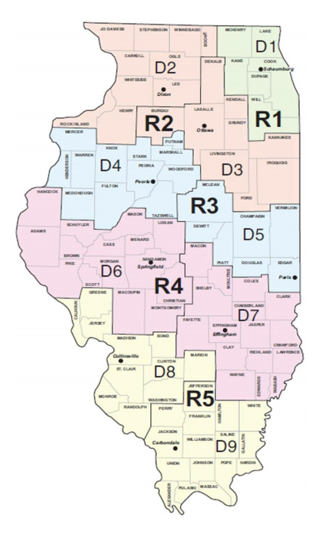
Illinois
Illinois Fun Facts
IDOT Districts
12.74 Million Residents
9.19 Million Licensed Drivers
147,028 centerline miles
621 Million transit passenger trips
Thousands of local governments

Slide 3
Rebuild Illinois 6-Year Total $44.8 ($ in billions)

Slide 4
Transportation Portion 74% of Rebuild Illinois 6-Year Total $33.2 ($ in billions)

Slide 5
State Portion 76% of the Transportation Portion 6-Year Total $25.3 ($ in billions)

Slide 6
Estimated TAMP Portion
Approximately 2/3rds of the state program is to achieve a state of acceptable condition for pavement (CRS ≥5) and bridges (NBI ≥ 5) as identified in our TAMP.
The target is for Interstates and other National Highway System have more facilities in a state of acceptable condition compared to State Marked Route and Unmarked State Route
TAMP decisions are made using data driven and tested methods to achieve state of acceptable condition and have our assets achieve a longer service life.
Some projects multi-task by achieving TAMP goals and other goals such as congestion relief.

Slide 7
District Distribution
District Needs
Fatalities (15%)
Road Lane Mile Needs (20%)
Bridge Deck Area Needs (20%)
District Demographics (45%)
Lane Miles
Bridge Deck Area
Annual Average Daily Traffic
Annual Vehicle Miles Interstate Lane Miles
Motor Vehicle Registration

Slide 8
Considerations for Project Prioritization
Safety
Asset Condition
Congestion
Economic Development
Local Priorities
Environmental Considerations
Project Timing
Resiliency
And so much more…..

Slide 9
Long Range Transportation Plan

Slide 10
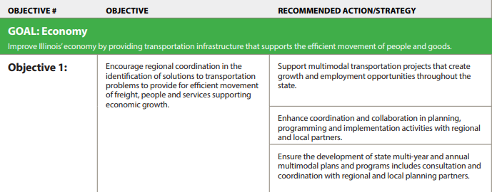
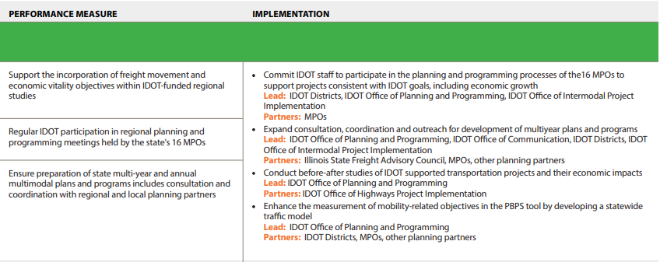
Performance Metrics - Planning

Slide 11
Federally Required Transportation Performance Management
Rule | Set Targets for:
Transit Asset Management | Equipment - State of Good Repair Facilities – State of Good Repair Infrastructure – State of Good Repair Rolling Stock – State of Good repair
Safety (PM1) | # of fatalities $ of Non-Motorized Fatalities and Non-Motorized Serious Injuries # of Serious Injuries Rate of Fatalities per 100 M VMT Rate of Serious Injuries per 100 M VMT
Pavement and Bridges (PM2) | % of Interstate Pavement in Good condition % of Interstate Pavements in Poor condition % of non-Interstate NHS pavements in Good condition % of non-interstate NHS pavements in Poor condition % of NHS bridges classified as in Good condition % of NHS bridge classified as in Poor condition
System Performance (PM3) | % of person-miles traveled on the Interstate that are reliable % of person-miles traveled on the non-Interstate NHS that are reliable Truck Travel Time Reliability Index Annual Hours of Peak hours Excessive Delay per Capita Percent of Non-Single Occupancy vehicle (SOV) Travel Total Emission Reductions
Final Planning Rule | Agreement with MPOs and transit agencies on how to share data and coordinate target setting.

Slide 12
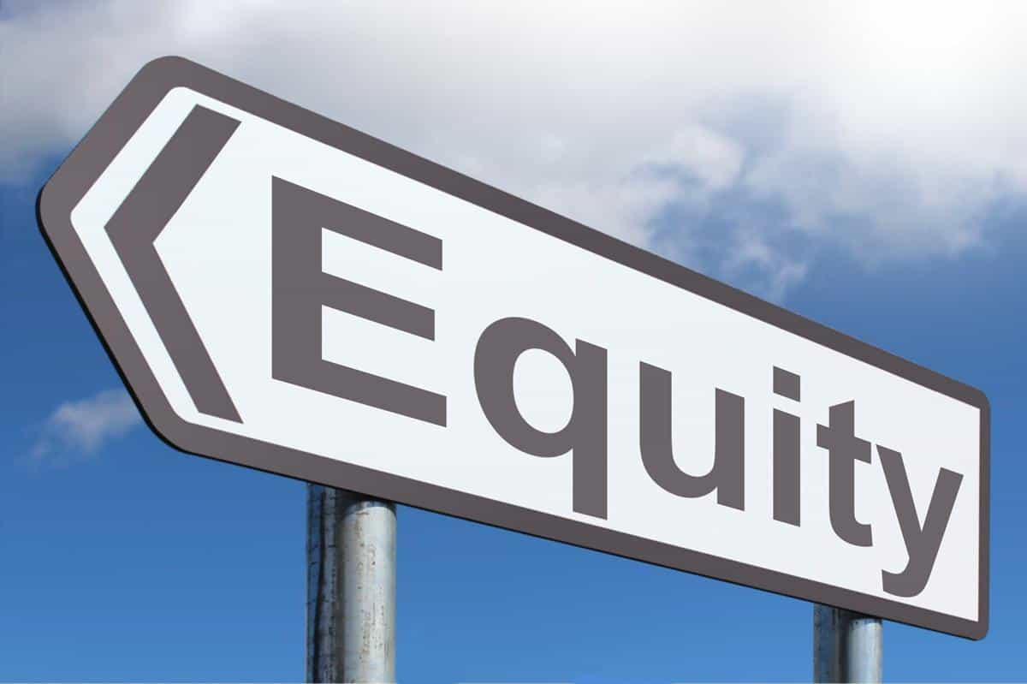
Equity Considerations
Disadvantaged Business Enterprises Goals
Environmental Justice
Project Specific
Planning & Programming Considerations
Specific Programs
ITEP - $105M for bike/ped in Rebuild Illinois
Statewide Planning and Research Funds
21 of 40 projects supporting disadvantaged/economically distressed communities
Rebuild Illinois Port Program
Project prioritization: Economic Growth for disadvantaged populations
Funding: Ports districts that cover areas that are both an EJ area defined by IEPA and a Economic Opportunity Zone defined by DCEO are eligible for 100% funding.
Rebuild Illinois Aeronautic Program
Rebuild Illinois Transit Program
This Photo by Unknown Author is licensed under CC BY-NC

Slide 13
Traci Sisk
Bureau Chief, Programming
Illinois Department of Transportation
Tracinda.Sisk@Illinois.gov
217-782-2755
Holly Bieneman
Bureau Chief, Planning
Illinois Department of Transportation
Holly.Bieneman@Illinois.gov
217-206-0655

