Slide 1
State of Illinois Illinois Department of Human Services

Slide 2
DHS: Towards an Integrated Framework
DEVELOPMENTAL
LEVEL OF
PRENATAL
CHILDREN
YOUTH
A
DULTS
DEATH
ENGAGEMENT
PRENATAL &
EARLY CHILDHOOD
POSITIVE YOUTH
ADULT
FAMILY SUPPORTS
DEVELOPMENT AND
DEVELOPMENT
INTERVENTION
&
SUPPORT
SERVICES
INTERVENTION
Basic Supports (Food,
Housing, Cash
Division of Human Capital Development
Assistance)
Development &
Early
Divisi
on of
Community Health & Prevention
Intervention
Division of Developmental Disabilities
Disability &
Rehabilitation Supports
Division of Rehabilitation Services
Division of Alcohol and Substance Abuse
Treatment
Division of Mental Health

Slide 3
DHS: OUTCOMES
Safety Net and Basic Supports– Basic cash, medical, housing, food assistance and work supports to our state’s most vulnerable families
Prevention and Early Intervention for Children and Youth
Community Integration and Maximum Independence for Illinois residents with physical, cognitive and developmental disabilities
Resiliency and Recovery for Illinois residents struggling with substance abuse and mental illness

Slide 4
Division of Human Capital Development – Providing a Safety Net
Performance Measures:

Slide 5
Division of Human Capital Development – Providing a Safety Net
Growing Demand/Decreasing Staff Levels

Slide 6
Budgeting for Results: IDHS Implementation
Identify Funding
Connect Funding to Programs
Compile current measurements
Initial Assessment
Performance Based Contracting
Outcome Based Management

Slide 7
Compile Current Measurements in Program Logic Format
OUTPUTS
Who? Where?
What?
How Well?
OUTCOMES
So what?; What was the benefit to the individual or family?
IMPACT
So what?; What was the benefit to the society, region or state?

Slide 8
Compile Current Measurements Performance Measures: What do we do and how well do we do it?
Outputs
Population & Sites
Population Reach
Client Characteristics
Services
Types of Services
Quality
Units of Service
Error Rates
Client Satisfaction
Unit cost
Certification
Location

Slide 9
Compile Current Measurements in Program Logic Format
OUTCOMES
So what?; What was the benefit to the individual or family?
IMPACT
So what?; What was the benefit to the society, region or state?

Slide 10
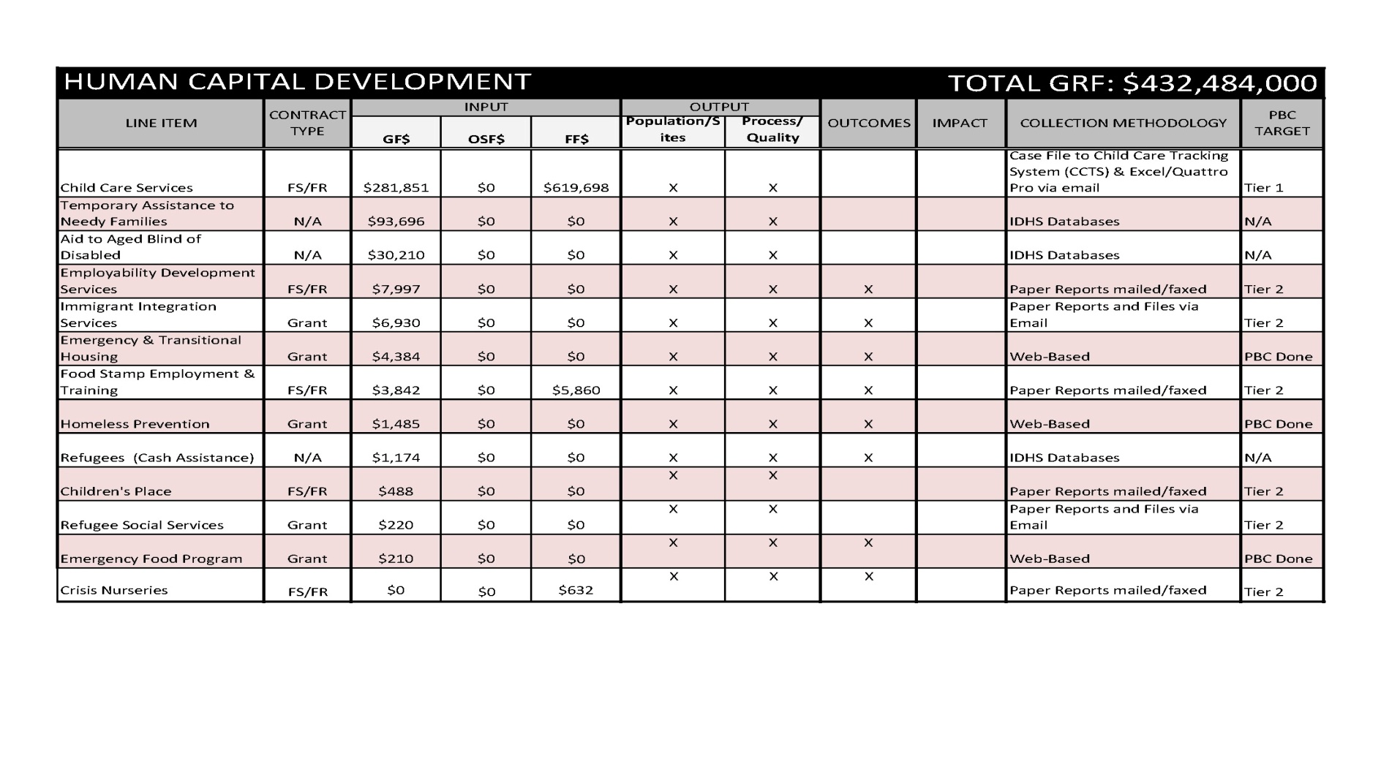
Compile Current Measurements in Program Logic Format

Slide 11
Budgeting for Results: IDHS Implementation
Identify Funding
Connect Funding to Programs
Compile current measurements
Initial Assessment
Revise Contract to require performance reporting
Include explicit measurements in each contract
Review and Refine Measurements & Monitoring
Performance Based Contracting
Outcome Based Management

Slide 12
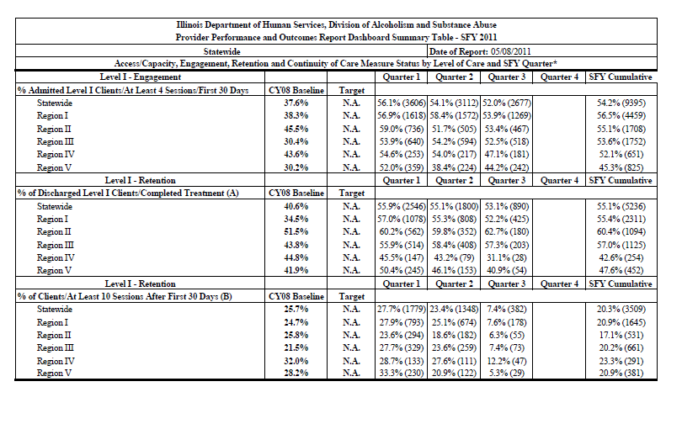
Division of Alcohol and Substance Abuse – PBC Dashboard Sample Page

Slide 13
Review and Refine Measurements
Improved Performance and Outcome Measurement
National and federal indicators
Evidence/research based indicators
Philanthropic partners
Provider partners
Other state’s performance dashboards

Slide 14
Budgeting for Results: IDHS Implementation
Identify Funding
Connect Funding to Programs
Compile current measurements
Initial Assessment
Revise Contract to require performance reporting
Include explicit measurements in each contract
Review and Refine Measurements & Monitoring
Performance Based Contracting
Define Program Logic Models
Improve Performance & Outcome Indicators
Refine Tracking & Reporting System
Outcome Based Management

Slide 15
Linking Investments & Outcomes
Appropriation Investment
Priority Outcome
Program/Initiative
Performance Indicators

